Slide 1
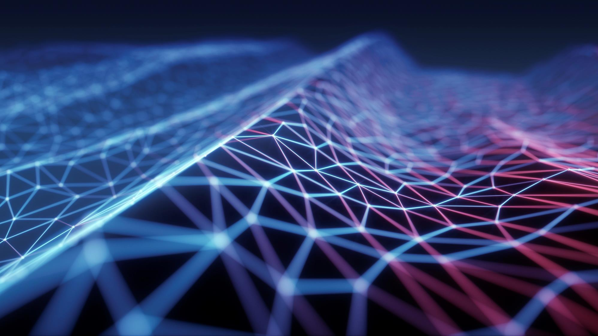
METAVERSE WEB 3.0
FAIZA MURTAZA

Slide 2

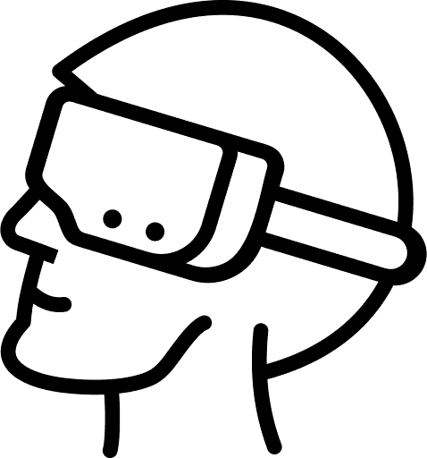
The metaverse is a virtual reality world where users can interact, game and experience things as they would in the real world.

Slide 3
Tech Requirements
metaverse
Web 3.0
blockchine

Slide 4
Introduction
The metaverse is a concept of a persistent, online, 3D universe that combines multiple different virtual spaces. You can think of it as a future iteration of the internet. The metaverse will allow users to work, meet, game, and socialize together in these 3D spaces.
The metaverse isn’t fully in existence, but some platforms contain metaverse-like elements. Video games currently provide the closest metaverse experience on offer. Developers have pushed the boundaries of what a game is through hosting in-game events and creating virtual economies.
The connections between the financial, virtual, and physical worlds have become increasingly linked. The devices we use to manage our lives give us access to almost anything we want at the touch of a button. The crypto ecosystem hasn't escaped this either. NFTs, blockchain games, and crypto payments aren't just limited to crypto geeks anymore. They're now all easily available as part of a developing metaverse.

Slide 5

Digital Communications
Blockchain, metaverse-like applications already exist and provide people with liveable incomes. Axie Infinity is one play-to-earn game that many users play to support their income. SecondLive and Decentraland are other examples of successfully mixing the blockchain world and virtual reality apps.

Slide 6
Digital Communications
The metaverse is a concept of an online, 3D, virtual space connecting users in all aspects of their lives. It would connect multiple platforms, similar to the internet containing different websites accessible through a single browser.
The concept was developed in the science-fiction novel Snow Crash by Neal Stephenson. However, while the idea of a metaverse was once fiction, it now looks like it could be a reality in the future.
Blockchain developers also take influence from the video game world too. Gamification is common in Decentralized Finance (DeFi) and GameFi. It seems there will be enough similarities in the future that the two worlds may become even more integrated

Slide 7
Digital Communications
The metaverse will be driven by augmented reality, with each user controlling a character or avatar. For example, you might take a mixed reality meeting with an Oculus VR headset in your virtual office, finish work and relax in a blockchain-based game, and then manage your crypto portfolio and finances all inside the metaverse.
You can already see some aspects of the metaverse in existing virtual video game worlds. Games like Second Life and Fortnite or work socialization tools like Gather.town bring together multiple elements of our lives into online worlds. While these applications are not the metaverse, they are somewhat similar. The metaverse still doesn’t exist yet.
Facebook is one of the loudest voices for the creation of a unified metaverse. This is particularly interesting for a crypto-powered metaverse due to Facebook's Diem stablecoin project. Mark Zuckerberg has explicitly mentioned his plans to use a metaverse project to support remote work and improve financial opportunities for people in developing countries. Facebook’s ownership of social media, communication, and crypto platforms give it a good start combining all these worlds into one. Other large tech companies are also targeting the creation of a metaverse, including Microsoft, Apple, and Google.
When it comes to a crypto-powered metaverse, further integration between NFT marketplaces and 3D virtual universes seems like the next step. NFT holders can already sell their goods from multiple sources on marketplaces like OpenSea and BakerySwap, but there isn’t yet a popular 3D platform for this. At a bigger scale, blockchain developers might develop popular metaverse-like applications with more organic users than a large tech giant.

Slide 8
Closing thoughts
While a single, united metaverse is likely a long way off, we already can see developments that may lead to its creation. It looks to be yet another sci-fi use case for blockchain technology and cryptocurrencies. If we will ever really reach the point of a metaverse is unsure. But in the meantime, we can already experience metaverse-like projects and continue to integrate blockchain more into our daily lives.

Slide 9
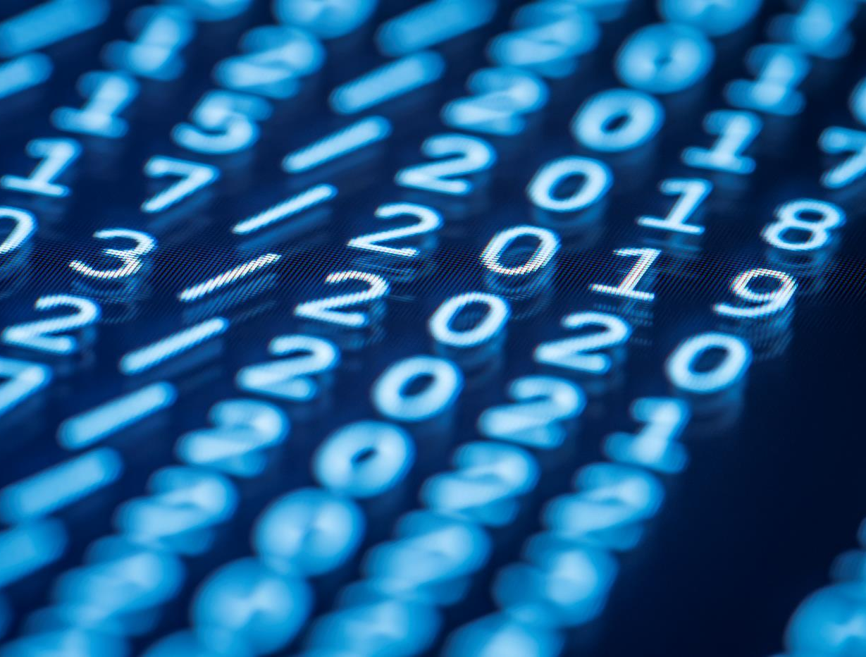
Thank You
faizamurtaza1990@gmail.com

